Slide 1

Expert Decision Replay — Overview
A single web app where teams capture, organize, and revisit important work decisions. It preserves rationale, options considered, approvals, and files so teams can learn from past choices and onboard faster.
Why it matters
Who it serves
Core benefit
Engineering, consulting, research, and cross-functional teams.
One canonical source for decisions, debate, and outcomes.
Keep institutional knowledge when people change roles or leave.

Slide 2
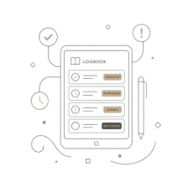




Milestone 2 — Completed Features
This phase delivered the foundational workflow: decision records, alternatives, file attachments, threaded discussion, and automatic versioning.
Decision Log
Alternatives
File Uploads
Discussion Board
Create, edit, and manage decisions with statuses: Draft, Under Review, Approved, Rejected, Archived.
Add options with cost, pros/cons, risk (Low/Medium/High), and feasibility for side-by-side comparison.
Attach PDFs, Word docs, and images directly to decisions and comments.
Threaded comments, nested replies, and formal meeting notes kept in-context.
Version History
Automatic snapshots on edit with restore capability to recover prior states.

Slide 3
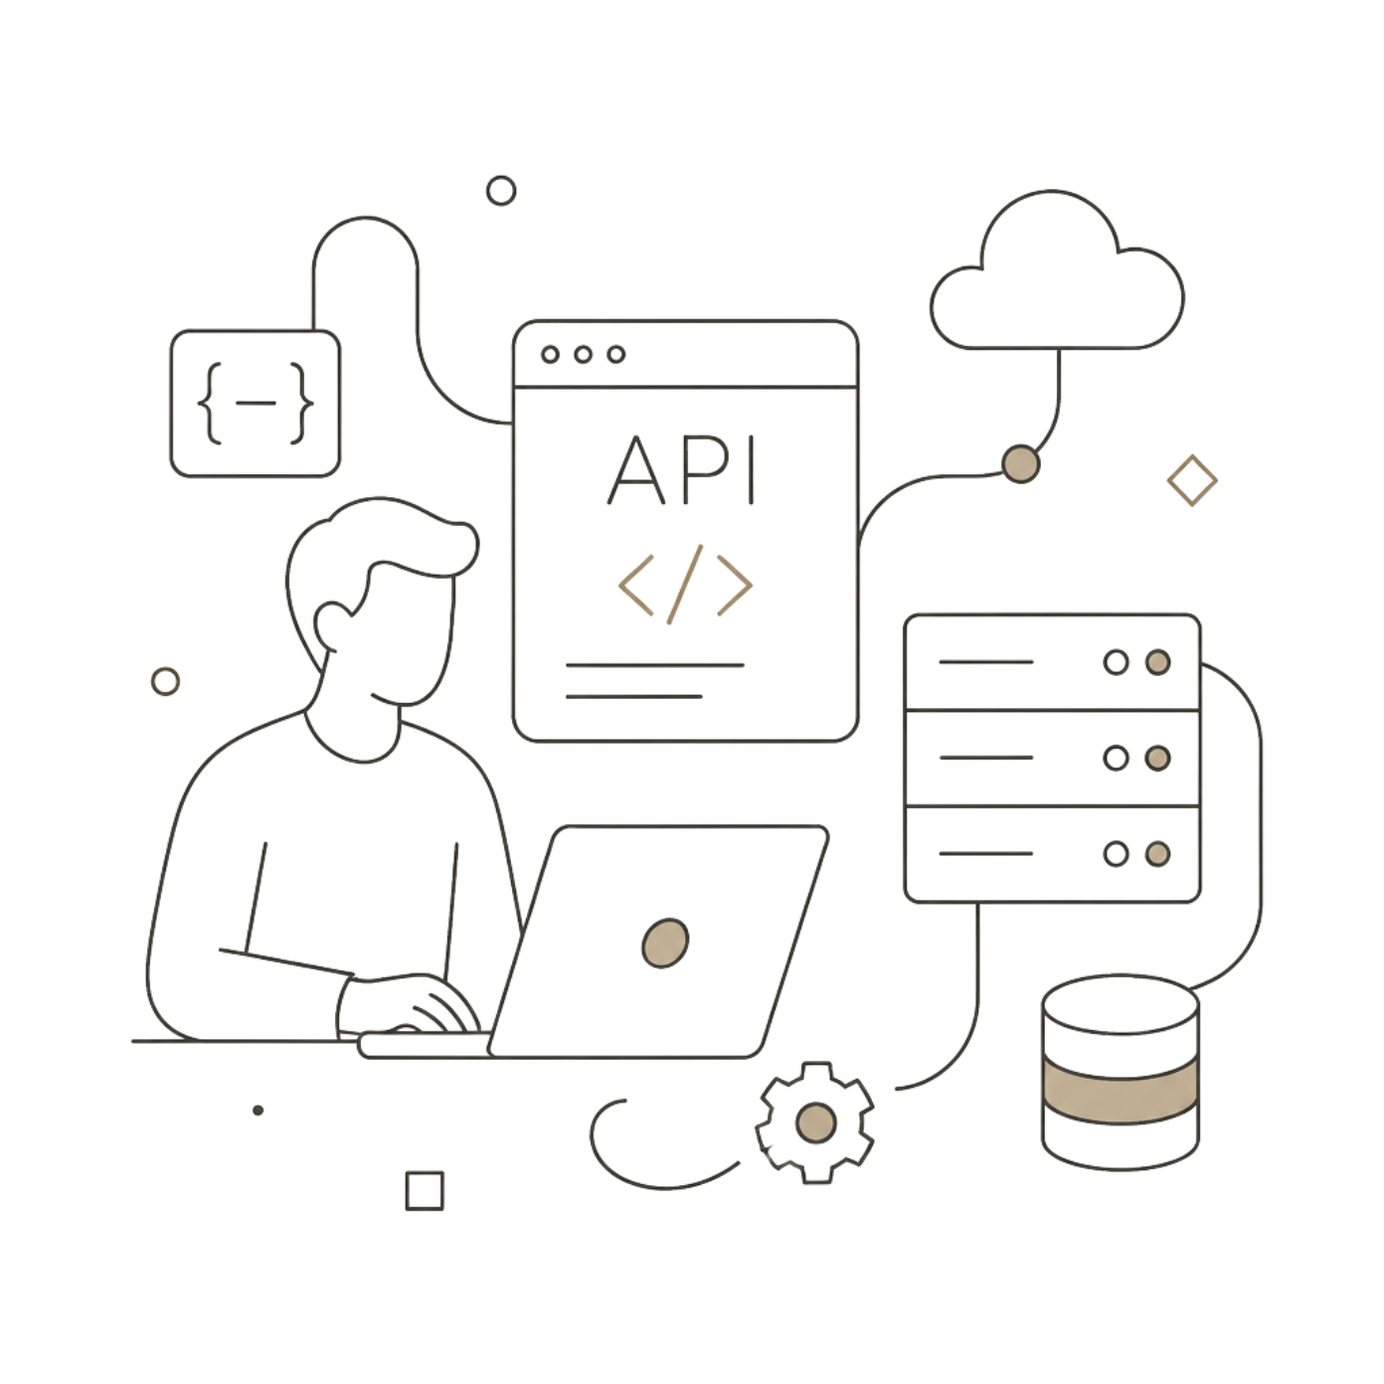
Project Architecture
Frontend
React + Vite for a fast, component-driven UI. Axios handles API requests and optimistic UI updates.
Backend
FastAPI (Python) provides REST endpoints with JWT-based authentication and role checks.
Storage
PostgreSQL for structured data (users, decisions, comments, versions). Files stored on server uploads folder (/backend/uploads).

Slide 4
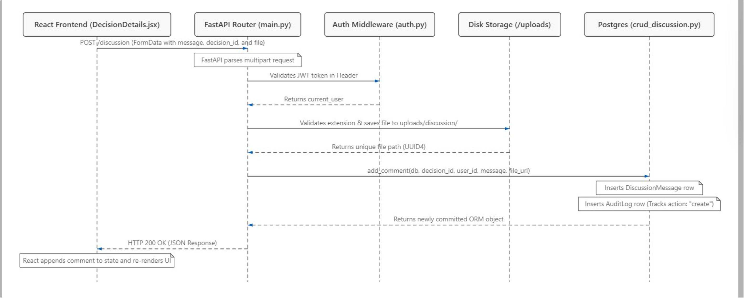
Workflow — Add Comment with File (Detailed Breakdown)

Slide 5
Step-by-Step Breakdown
Here is what happens step-by-step when a user adds a comment with a file:
Backend Security & Files (FastAPI)
Frontend (React)
The backend checks the user's login token (auth.py). The upload code checks the file type (only .pdf, .docx, .jpg, .png are allowed) and size (under 5MB). The file is saved in the server's uploads folder with a unique name (main.py).
The user types a comment, attaches a file, and clicks "Post" on the UI (DecisionDetails.jsx). The frontend package creates a form request and sends it via Axios to the backend API (POST /discussion).
UI Update
Database (SQLAlchemy)
The frontend receives the successful response and immediately displays the comment on the screen without reloading the page.
The code creates a new comment record linked to the decision (crud_discussion.py). It also saves a log entry in the audit_logs table (who did it, when, and on which decision). The database saves the changes, and the backend sends the new comment back to the frontend.

Slide 6
Module Justification
Decision Management Module
Version History Module
Alternatives Comparison Module
Problem: Teams make decisions on chat apps like Slack or in quick meetings. The details get lost quickly, and nobody remembers the final choice weeks later.
Solution: Gives the team a single place to write down the problem, the category, and track the status (Draft → Under Review → Approved).
Problem: A decision might be updated multiple times. If someone edits the text, the original ideas and approvals are lost.
Solution: The system saves a backup copy (DecisionVersion in database) every time a decision is edited. If a mistake is made, you can click "Restore" to go back to any older version.
Problem: Teams often pick the first idea they have without writing down other options, their costs, or their risks.
Solution: Lets users add multiple options (alternatives) to one decision. You can view pros/cons, cost, risk, and feasibility side-by-side to make a smart choice.

Slide 7
Module Justification (Continued)
File Upload Module
Discussion & Meeting Notes Module
Problem: Teams refer to external charts, mockups, or documents. Storing links in shared drives can break, or team members might lose access.
Solution: Lets you upload documents directly into the app. Files are saved securely on the server and are always visible to anyone viewing the decision.
Problem: Conversations about a decision happen all over the place (emails, meetings, chats). People who look at the decision later cannot see why the team agreed or disagreed.
Solution: Places a message board directly inside the decision page. Teams can have normal discussions, write nested replies to specific questions, or post formal meeting notes.

Slide 8
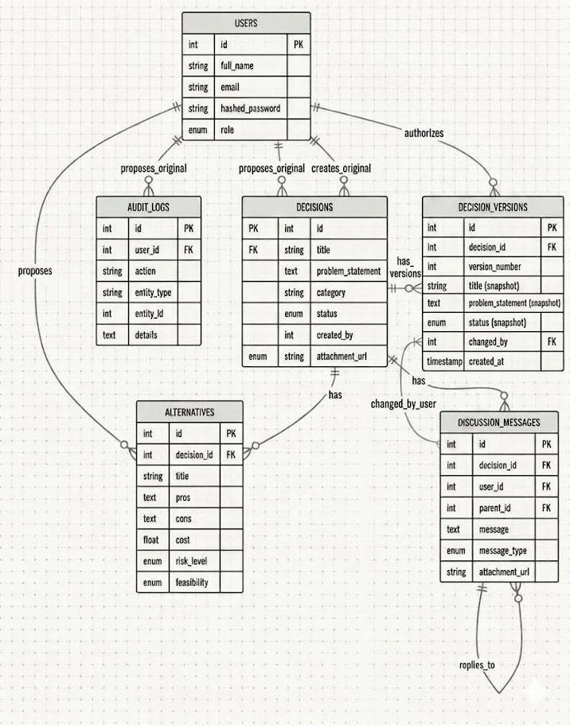
ER diagram

Slide 9
Security, Audit & Operations
Security
Operational Practices
JWT authentication + role checks (author, reviewer, admin).
File safety: MIME/extension validation, size limits, unique non-guessable filenames.
PostgreSQL backups and tested restore procedures.
Periodic snapshots of uploads folder and retention policy for files.
Monitoring for failed uploads, auth errors, and suspicious activity.
Audit
Every create/edit/delete and file action writes an audit_log entry (user, timestamp, decision id, action) for traceability.
These controls ensure decision records remain trustworthy and recoverable — critical for teams relying on the platform for governance and audits.

